Slide 1

FUNDO TV
Entertainment on the go

Slide 2
FUNDOTV OVERVIEW
Vehicle-based Entertainment Platform
Single appliance solution
Built-in WiFi Router, Video Processor & Storage
High-Performance and throughput WiFi Router
Special optimized algorithm for video streaming
Content Management System
Rugged, weather-proof IP-65 enclosure
Special power circuit to handle voltage flucutations

Slide 3
FUNDOTV ADVANTAGES
Bus Operator Benefits
Key Differentiator
Customer Experience
Customer Loyalty
Easy deployment
Increase Revenues
Centrally Manage
Simple plug-n-play deployment
Rugged weatherproof enclosure
Single console management
Integrated Hotspot Features
Zero configuration deployment
Content Management System
Data Analytics & Reporting

Slide 4
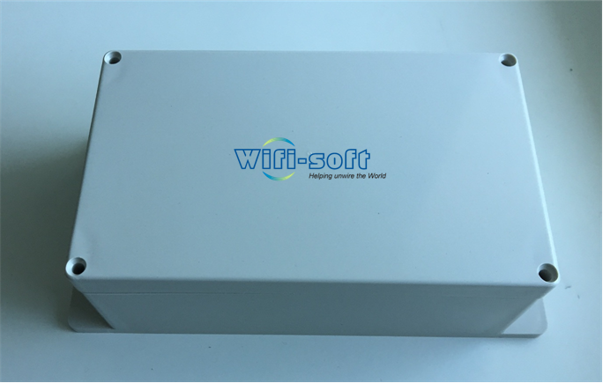
MOBIMAX MODELS
FTV-40C | FTV-60C
WiFi-based Entertainment Router | WiFi-based Entertainment Router
Single 802.11ac WiFi Module | Dual 802.11ac WiFi Module
Supports 40 streaming clients (2.4 GHz + 5 GHz) | Support 60 streaming clients (2.4 GHz + 5 GHz)
500 GB HDD storage | 1 TB HDD Storage
18V battery power | 18V battery power
Weatherproof, IP65 plastic enclosure | Weatherproof, IP65 plastic enclosure

Slide 5
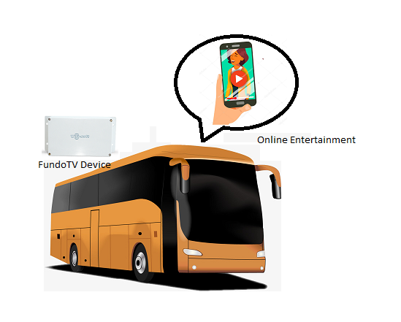
DEPLOYMENT ARCHITECTURE

Slide 6
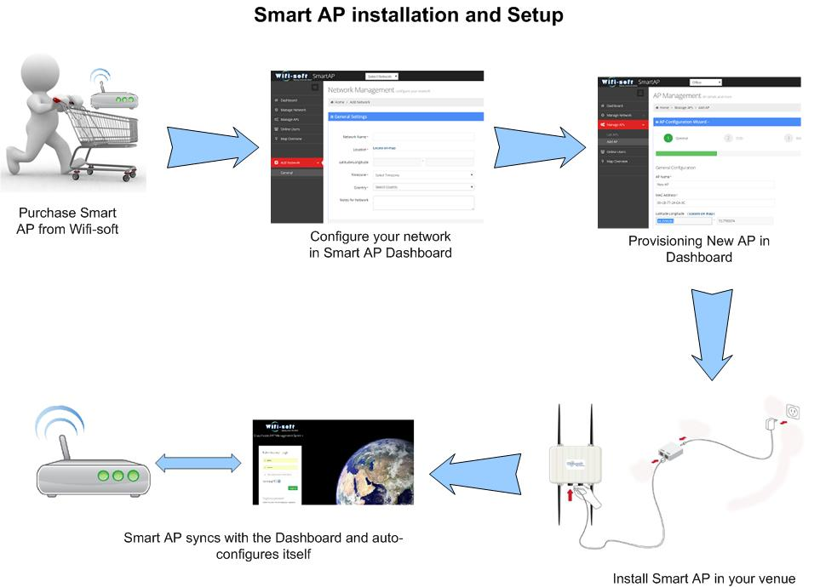
FUNDOTV SETUP

Slide 7
FUNDO-TV FEATURES
All-in-one appliance
Zero configuration
Personalized Content Pages
User Analytics
Optimized Videos
In-browser Streaming App
Web App
Ad Injection*
Revenue Tracking
Content Management System
Content Classification
Automatic Updates
* Coming soon

Slide 8
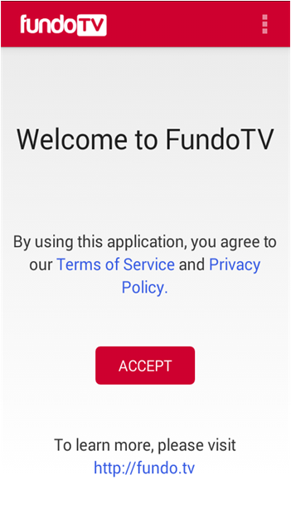
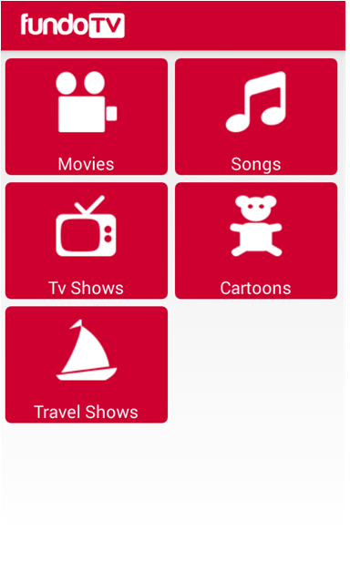
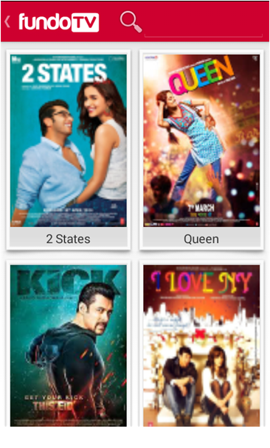
FUNDOTV SCREENSHOTS

Slide 9
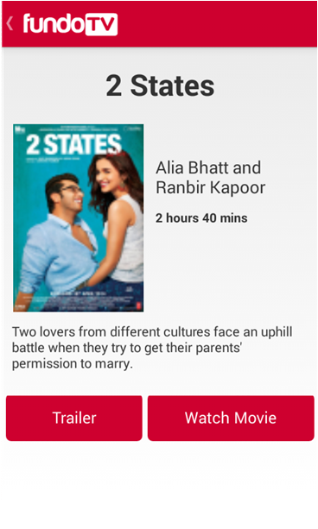
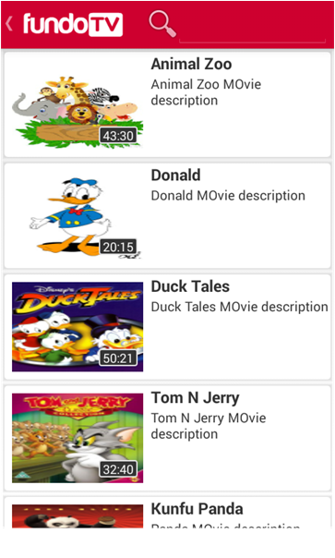
FUNDOTV SCREENSHOTS

Slide 10
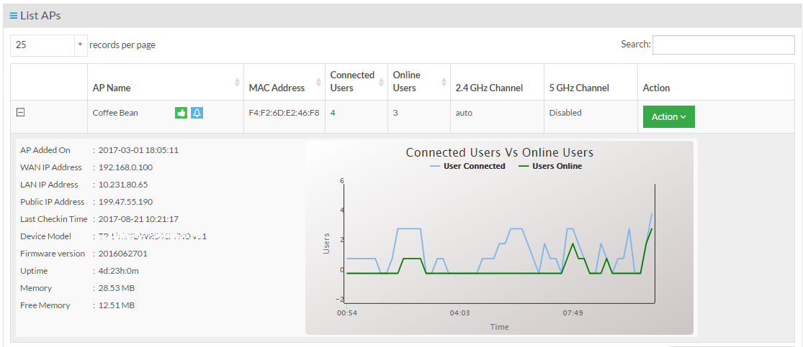
DASHBOARD
Single console management
User Management
Plug-n-play installation
Central Upgrades
Usage Analytics
Content Manager
Manage Ads*
* Coming soon

Slide 11
THANKS!
Any questions?
Please contact us at
sales@wifi-soft.com | +1-866-554-5090 | +91-20-3018-5500

