Slide 1



UniBox
GET TO KNOW US
Reliable and Scalable Network Controller
for All Large & Small Venues.
1
Copyright © 2018 Wifi-Soft Solutions Pvt. Ltd. All rights reserved. Do not copy without prior permission

Slide 2









ABOUT US
Long list of satisfied clients
Wifi-soft provides a complete range of wireless networking solutions for managing public and private wireless networks and Wi-Fi hotspots. A few statistics about our company are as below,
Among the top 3 hotspot
companies in the world
Presence in 45+
Countries
Full range of WiFi
Products
10000+ venues
Offices in USA,
UAE and India
Multiple awards and
recognitions
14+ years of industry
leadership
Resellers in
20+ countries
24x7 customer
support
2
Copyright © 2018 Wifi-Soft Solutions Pvt. Ltd. All rights reserved. Do not copy without prior permission

Slide 3


INTRODUCTION
UniBox can be installed in any public venue like hotels, cafes, schools/colleges, hospitals, shopping malls, travel venues and even private offices to control, manage and monitor internet access.
UniBox is deployed in two configurations:
Standalone mode
Cloud-managed mode
Copyright © 2018 Wifi-Soft Solutions Pvt. Ltd. All rights reserved. Do not copy without prior permission

Slide 4
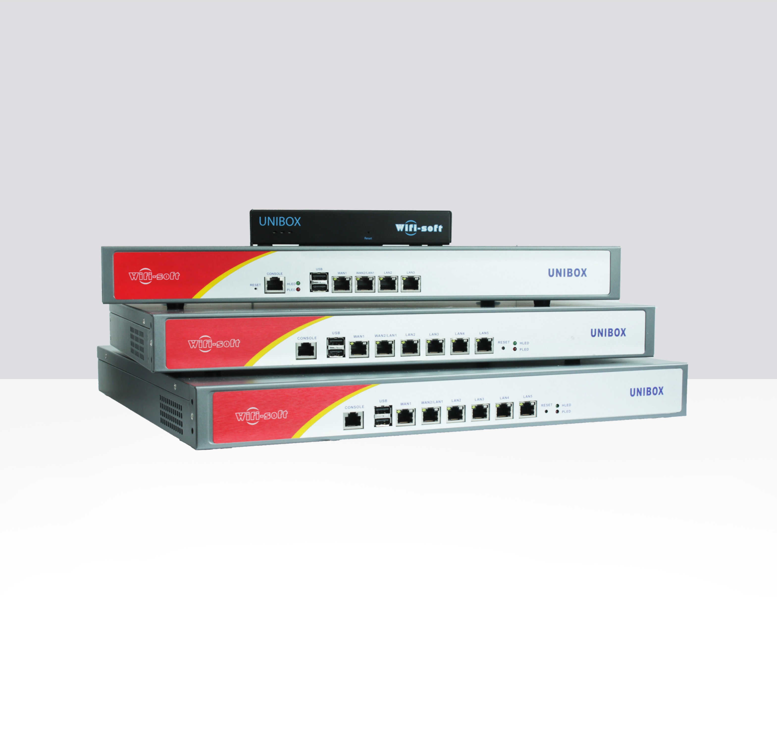






UNIBOX CONTROLLERS
Hotspot Controller
Firewall
Access Point Controller
VPN Server / Branch Networking
Web Logger
Multi-WAN Router
Portal Server
Hotspot Billing Server
Advertisement Server
Enterprises
Education
Hospitality
Transport
Retail
Public WiFi
4
Copyright © 2018 Wifi-Soft Solutions Pvt. Ltd. All rights reserved. Do not copy without prior permission

Slide 5
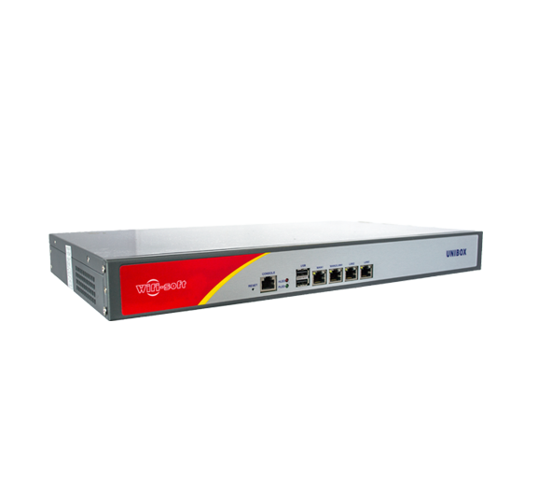
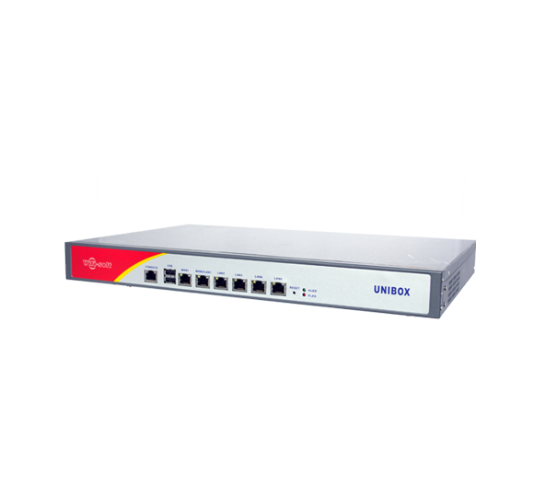
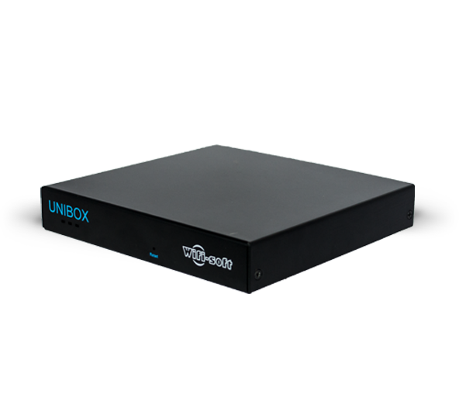
SMB Series
UNIBOX U50 & U100
(50 - 100 concurrent users)
Enterprise Series
Campus Series
UNIBOX U200 & U500
(200 - 500 concurrent users)
UNIBOX U1000 & U2500
(1000 - 2500 concurrent users)

Slide 6
UNIBOX ADVANTAGES
Value Addition
Bandwidth Control
Full Network Visibility
Branding
Monetize Hotspots
Single Console Mgmt
Friendly Help Desk
Benefits
All-in-one Controller
Compliance & Audits
Intuitive User Interface
Reliable & Secure Network
Reduces IT Cost
Streamline Operations
Copyright © 2018 Wifi-Soft Solutions Pvt. Ltd. All rights reserved. Do not copy without prior permission

Slide 7
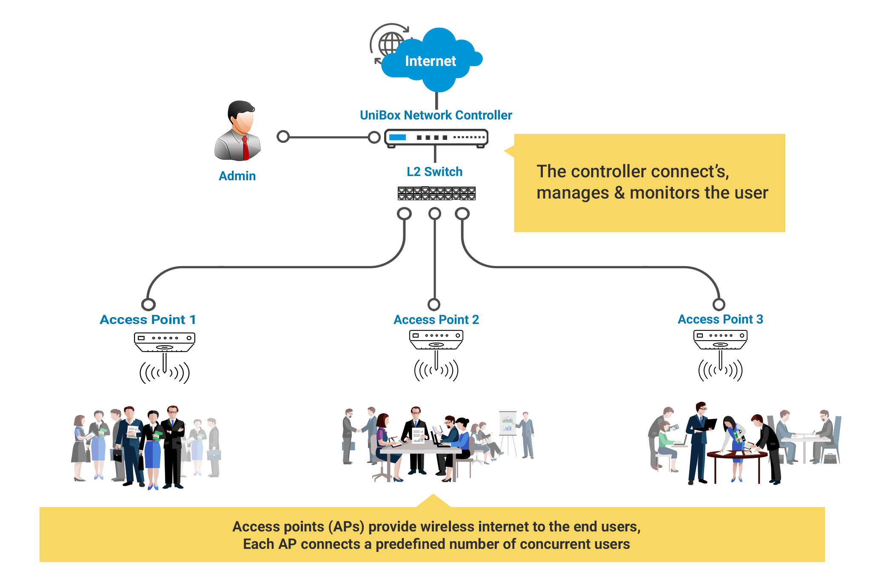
DEPLOYMENT ARCHITECTURE
Copyright © 2018 Wifi-Soft Solutions Pvt. Ltd. All rights reserved. Do not copy without prior permission

Slide 8
UNIBOX CONTROLLER
KEY FEATURES
8
Copyright © 2018 Wifi-Soft Solutions Pvt. Ltd. All rights reserved. Do not copy without prior permission

Slide 9
UNIBOX CONTROLLER
Controller + AAA Server
Hotspot Billing
Captive Portals
Bandwidth/ Policy Manager
Social Media & Analytics
BYOD
AP Management
Web logs & URL Filter
Vouchers
User Management
PMS Integration
SMS / OTP Authentication
9
Copyright © 2018 Wifi-Soft Solutions Pvt. Ltd. All rights reserved. Do not copy without prior permission

Slide 10











Slide 11

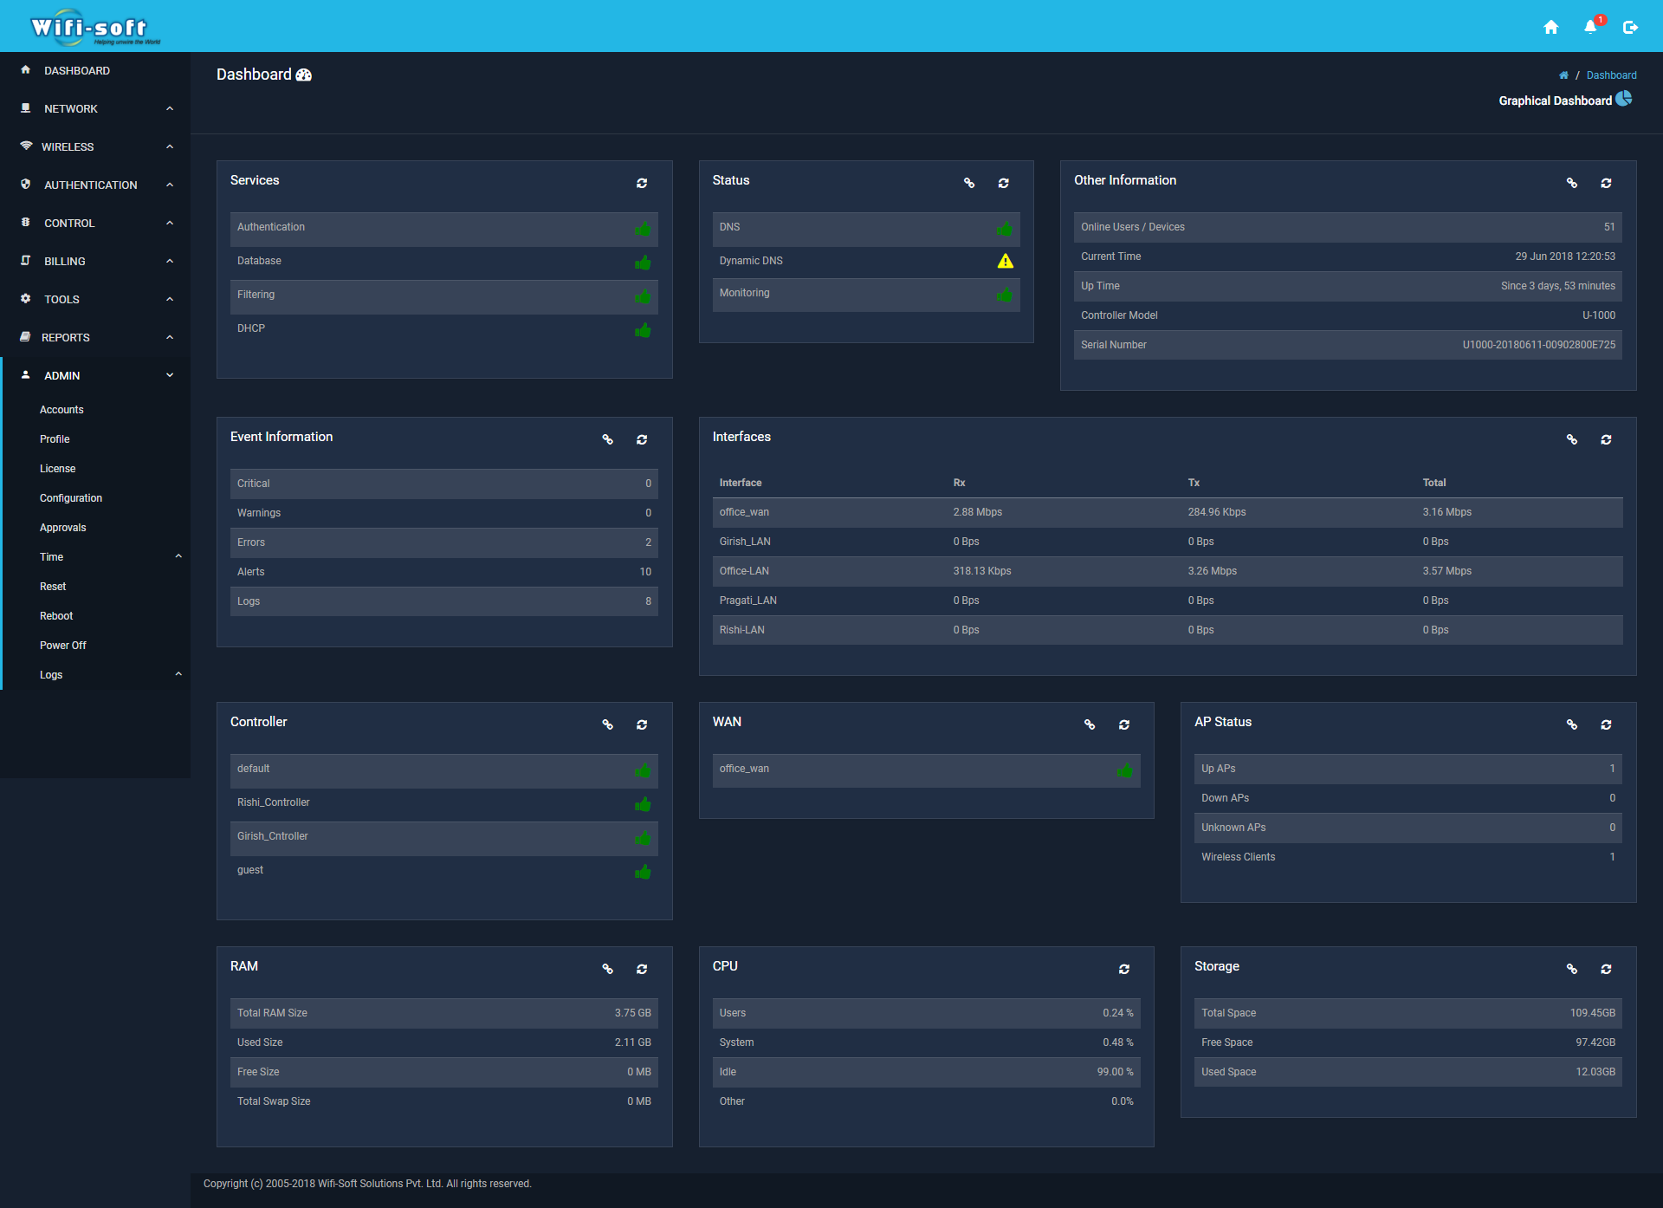
UNIBOX
DASHBOARD
Copyright © 2018 Wifi-Soft Solutions Pvt. Ltd. All rights reserved. Do not copy without prior permission

Slide 12




Splash Page Redirection
AAA Server
Bandwidth Control
User Session Management
DHCP/IP Management
RADIUS attributes
Policy Management
Wall Garden URLs
HOTSPOT
CONTROLLER
Copyright © 2018 Wifi-Soft Solutions Pvt. Ltd. All rights reserved. Do not copy without prior permission

Slide 13
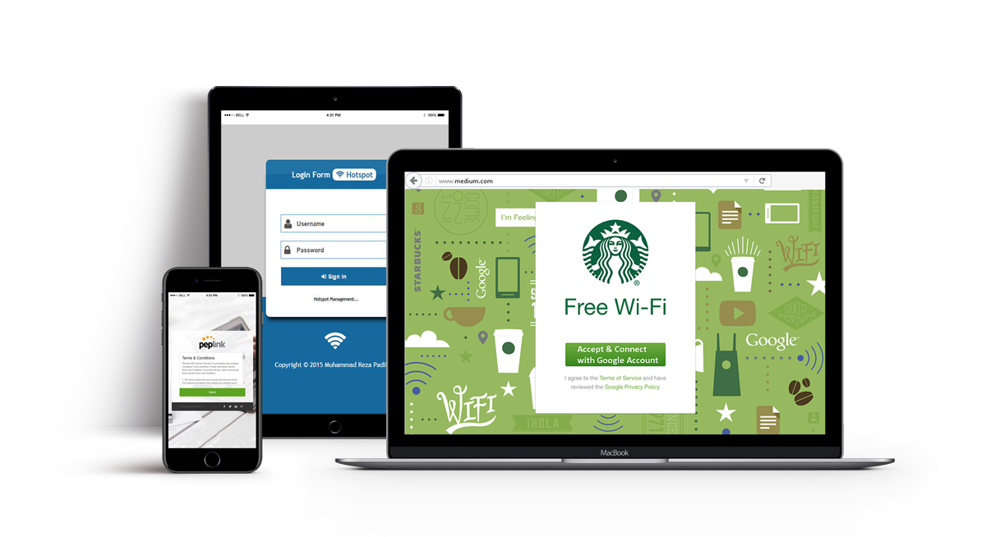
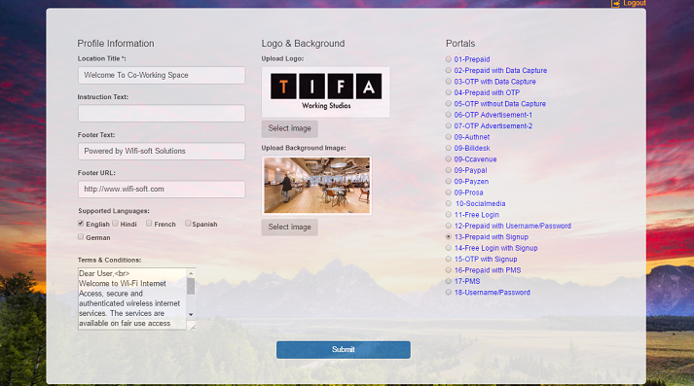
CAPTIVE PORTAL
Click-and-customize portal templates
Locally store captive portal for fast loading times
Multi-lingual
Full branding with custom logo and design
SSL support
20 different portal templates
Mobile-friendly, Responsive Designs
Copyright © 2018 Wifi-Soft Solutions Pvt. Ltd. All rights reserved. Do not copy without prior permission

Slide 14
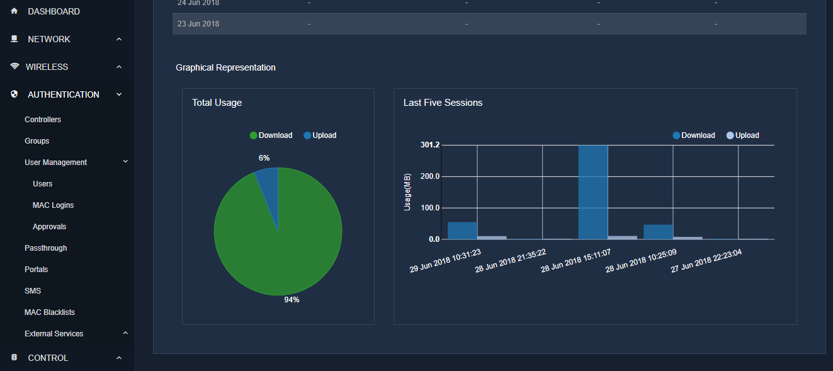
USER MANAGEMENT
Local / Remote user authentication
Per user bandwidth control
Group-based user policies
Auto-MAC binding for seamless login
Approval-based on-boarding
Seamless user provisioning
Detailed user logs & activity tracking
Copyright © 2018 Wifi-Soft Solutions Pvt. Ltd. All rights reserved. Do not copy without prior permission

Slide 15
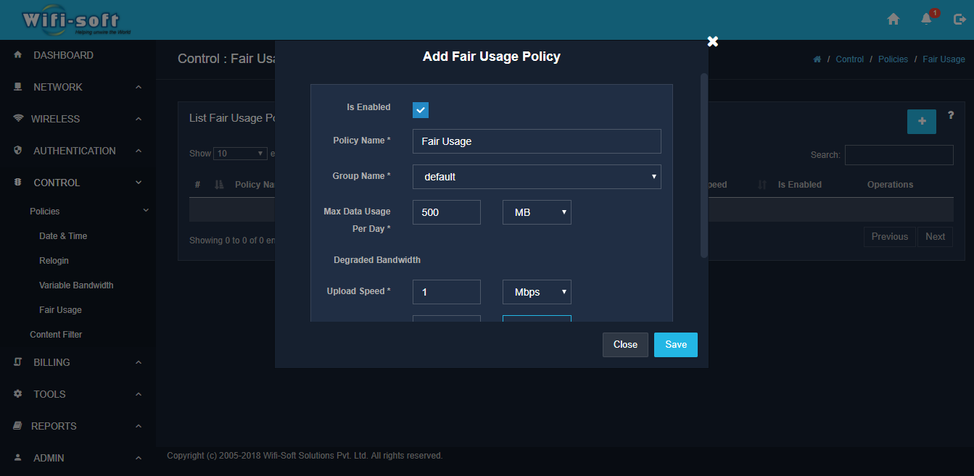
BANDWIDTH CONTROL
Restrict bandwidth usage per user or group
Time & Bandwidth Quota based access
Dynamically shape user’s bandwidth
Fair usage and load balancing policy
Prioritize packets based on traffic analysis
Detect and block torrents, file sharing and P2P applications
Upsell bandwidth with tiered pricing
Copyright © 2018 Wifi-Soft Solutions Pvt. Ltd. All rights reserved. Do not copy without prior permission

Slide 16
Policy Manager
Date & Time Policy
Variable bandwidth Policy
Fair Usage Policy
Re-login Policy
Contention Ratio based bandwidth allocation
POLICY
MANAGER
16
Copyright © 2018 Wifi-Soft Solutions Pvt. Ltd. All rights reserved. Do not copy without prior permission

Slide 17
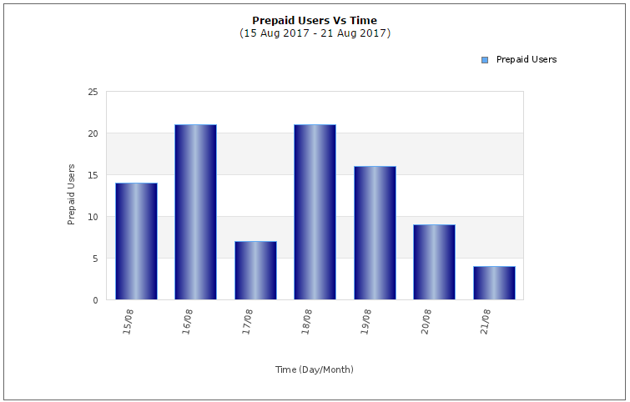
HOTSPOT BILLING
Multiple billing options – credit card, PayPal, PMS, Vouchers, etc
Time, quota, speed, devices & concurrency restrictions
Seamless integration with captive portal
Design custom billing plans
Integration with leading Hotel PMS
Unlimited prepaid vouchers
Canned email templates
Copyright © 2018 Wifi-Soft Solutions Pvt. Ltd. All rights reserved. Do not copy without prior permission

Slide 18
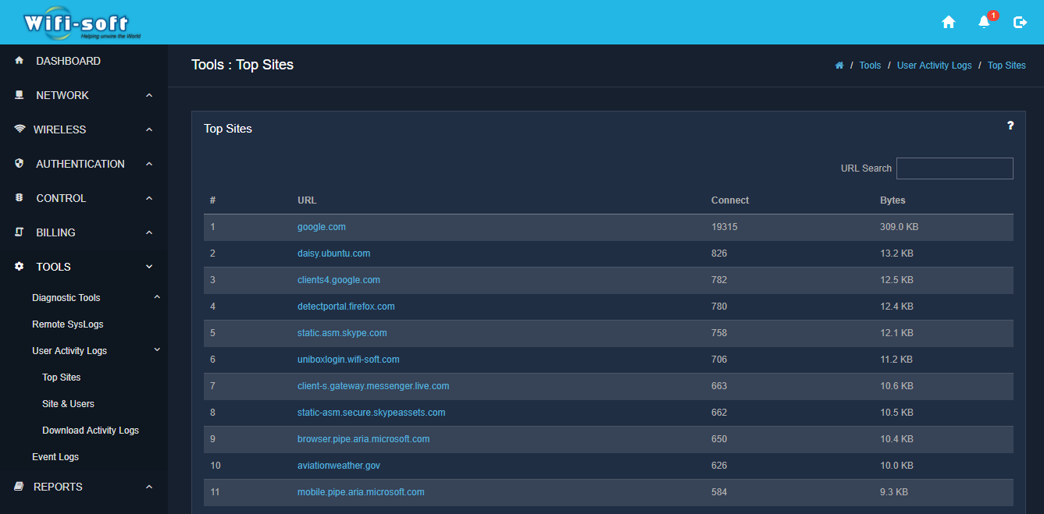
WEB LOGGING & FILTERING
Log web activity for all users
Filter URLs based on categories
Weekly update of URL database
Remote syslogs
Detailed logs of user activity
Trace Torrent/P2P usage
Copyright © 2018 Wifi-Soft Solutions Pvt. Ltd. All rights reserved. Do not copy without prior permission

Slide 19



SOCIAL MEDIA INTEGRATION
Integration with Facebook, LinkedIn, Twitter & Google
User profiling
Seamless integration with captive portals
Facebook check-in & Like options
Export user profiles & visitor logs
Analyze usage trends
Copyright © 2018 Wifi-Soft Solutions Pvt. Ltd. All rights reserved. Do not copy without prior permission

Slide 20




PMS INTEGRATION
Add-on PMS module
Integration with leading PMS providers
Virtual PMS for non-PMS venues
Import/Export user data and PMS transactions
Detailed logs of all PMS exchange
Seamless Bill-To-Room integration
Custom integration *
* Custom integration available on request
Copyright © 2018 Wifi-Soft Solutions Pvt. Ltd. All rights reserved. Do not copy without prior permission

Slide 21
REPORTING
Usage Reports
Billing Reports
Network Reports
System Reports
              User Sessions
              Bandwidth Usage
              Real-time Usage
              ISP Utilization
              Online Users
              Top Users
              User Agents
              Users over time
Consolidated Billing
Revenue by Date
Revenue by Plans
Voucher Report
Signup Report
PMS Revenue
AP Status
Port Status
ISP Bandwidth
Network Status
AP Auto discovery
ARP Tables
Wireless Clients
System Usage
ARP Tables
System Information
Port Connections
DHCP Leases
User Agents
Copyright © 2018 Wifi-Soft Solutions Pvt. Ltd. All rights reserved. Do not copy without prior permission

Slide 22
SOLUTIONS
22
Copyright © 2018 Wifi-Soft Solutions Pvt. Ltd. All rights reserved. Do not copy without prior permission

Slide 23

RETAIL SOLUTIONS
Enterprise Access Points
Push Notifications
Central Management
Portal Advertisements
Branded Captive Portals
SMS/Email Marketing
Customer Surveys
Social Media Integration

Slide 24









ENTERPRISE
SOLUTIONS
LDAP/AD
Integration
URL
Filtering
Bandwidth &
Policy Mgmt
Powerful
Dashboard
Access
Point
Controller
Moble Device
Management
Enterprise
Access
Points
Guest Access /
Captive Portal

Slide 25





HEALTHCARE SOLUTIONS
Enterprise Access Points
Powerful Dashboard
Network Access Controller
Web Logger
Branded Captive Portals
URL Filtering
Bandwidth & Policy Mgmt.
LDAP/AD Integration
Notes:
add bus, Path Lab, clinics,

Slide 26


DHCP Server
Outdoor
Access Points
Bandwidth &
Policy Mgmt.
Monetization
Platform
Powerful
Dashboard
Central AP
Controller
Advertisement
Platform
Central AP
Controller

Slide 27

HOSPITALITY
SOLUTIONS
Enterprise Access Points
Powerful Dashboard
Social Media and Ads
Prepaid Vouchers
Branded Captive Portals
PMS Integration
Bandwidth & Policy Mgmt.
Hotspot Controller

Slide 28


Network
Access
Controller
Web
Logger
LDAP/AD
Integration
URL
Filtering
Enterprise
Access
Points
Student
Portals
Bandwidth &
Policy Mgmt
Powerful
Dashboard
EDUCATION SOLUTIONS

Slide 29
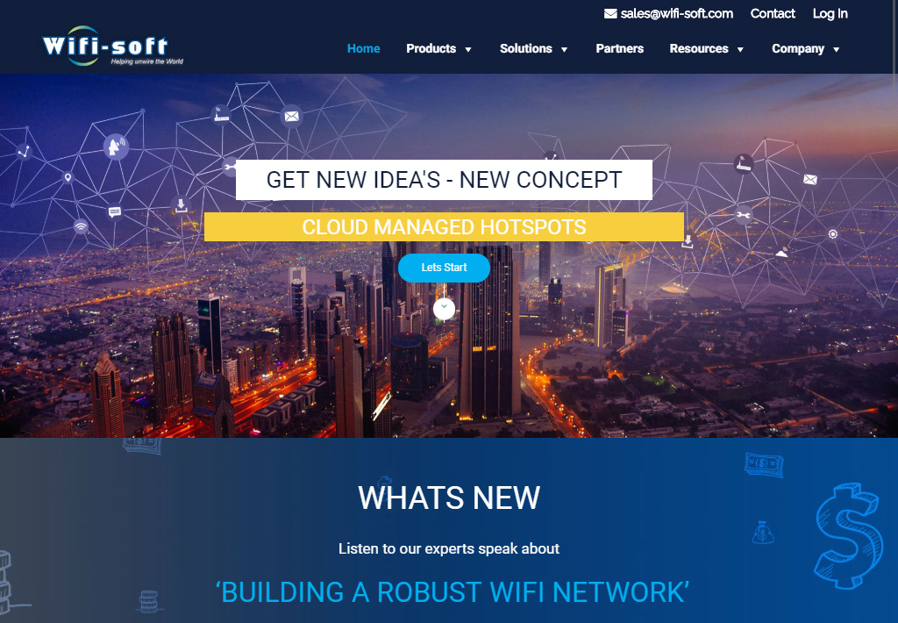
VISIT OUR
WEBSITE TODAY
VISIT NOW
29
Copyright © 2018 Wifi-Soft Solutions Pvt. Ltd. All rights reserved. Do not copy without prior permission

Slide 30
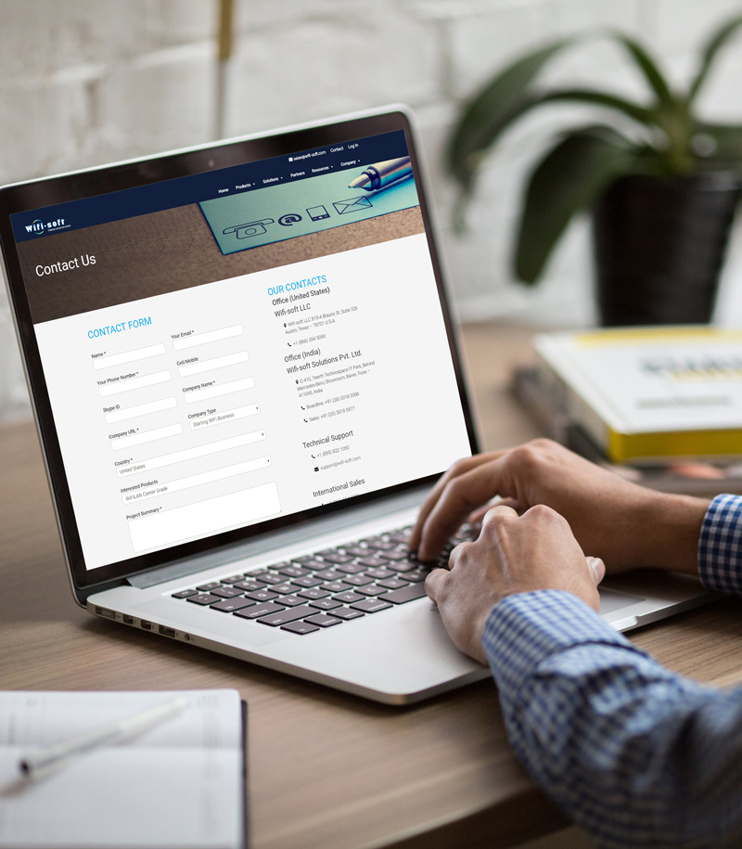




CONTACT US
Wifi-soft Solutions Pvt. Ltd.
Wifi-soft LLC
815-A Brazos St, Suite 326 Austin, Texas - 78701 U.S.A.
+1 (866) 554 5090
C-410, Teerth Technospace IT Park, Baner, Pune - 411045, India
+91 (20) 3018 5577
sales@wifi-soft.com
30
Copyright © 2018 Wifi-Soft Solutions Pvt. Ltd. All rights reserved. Do not copy without prior permission

