Slide 1
WIFILAN Cloud

Slide 2
Wifisoft Overview
1

Slide 3
Wifisoft is a 12 year old company which specializes in managing and monetizing public WiFi hotspots worldwide.

Slide 4
INTRODUCTION
Established in 2005
Founders with over 15 years of WiFi expertise
Customers in over 40 countries
Serves 10+ million users each month
Managed over 10,000 hotspots worldwide
OEM for APs, Controllers, Cloud-managed Hotspots

Slide 5
HISTORY
2006 – WiFiLAN v1.0
2008 – Expansion
of US client base
2010 – UniBox 1.0
2012 – 8000+ hotspots
2015 – 10+ million monthly users
2005 – Founded
2007 Whole Foods
1000+ Hotspots
Products sold in 30+ countries
2014 – Access Points launched
2016 - 10000+ hotspots

Slide 6
PRODUCTS & SERVICES
WIFILAN CLOUD
UNIBOX
UNIMAX AP
Indoor & Outdoor APs
Multiple SSIDs
Cloud-Controller Managed
Wireless Mesh
Long Range
Plug-n-play setup
Captive Portal
Auto-channel Selection
802.1x/RADIUS
Bandwidth Control
Captive Portals
Hotspot Billing
Subscriber Mgmt
Monitoring & NMS
Bandwidth Control
Policy Enforcement
Social Media
Reporting/Analytics
Venue Dashboards
Hotspot Controller
Built-in AAA
Hotspot Billing
Captive Portals
Bandwidth Mgmt
Multiple Login Methods
Policy Enforcement
PMS Integration
URL Logging

Slide 7
CUSTOMERS
System Integrators
ISP / Service Providers
Retail
Hospitality

Slide 8
VENUES SERVED

Slide 9
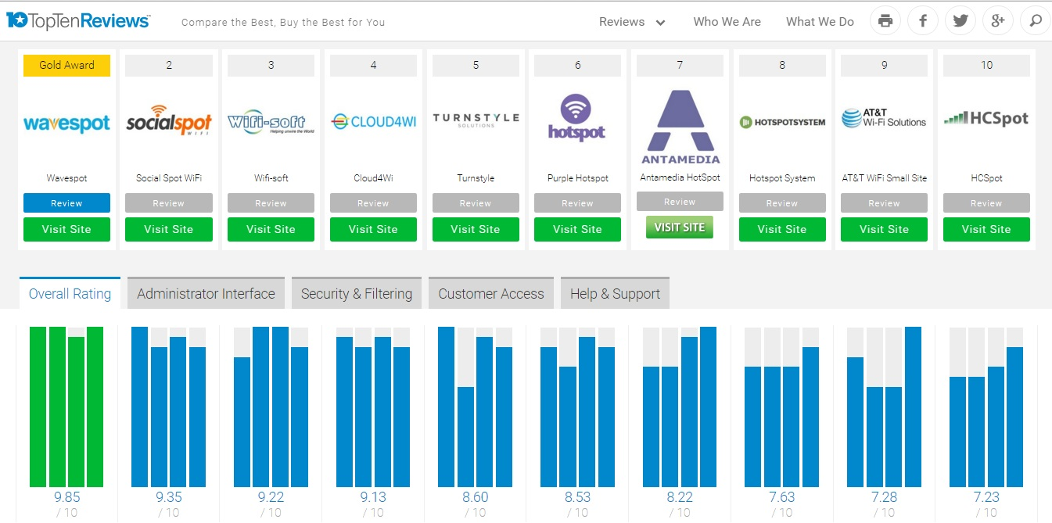
AWARDS/RECOGNITIONS
Wifisoft recognized in top-3 WiFi solution worldwide
Wifisoft - Brand of the year (2016) for WiFi Hotspots

Slide 10
MANAGEMENT
Rishi Ghare Co-Founder/CEO 21 years industry experience 15 years WiFi experience MS – U-Texas, Btech – Computer Science | Sohail Ahmad CTO 12 years WiFi experience Mtech – IIT Rourkee, Btech – Computer Science | Murray Freeman Co-Founder Serial Entrepreneur 40+ years industry experience Founder of Wifi-Texas, PoE-Texas, Airimba

Slide 11
WiFiLAN Cloud
Cloud-based Hotspot Management Platform

Slide 12
WIFILAN OVERVIEW
Complete OSS/BSS/NMS solution for public WiFi hotspots
Seamless and user friendly captive portal experience
Various billing methods – credit card, PMS, vouchers
Subscriber management
Bandwidth and QoS management
External Integration – SMS, Payment Gateway
Multi-vendor support
Reporting & Analytics

Slide 13
WIFILAN ADVANTAGES
Benefits
Pay as you go model
White-labeling & Branding
Intuitive User Interface
Multi-Vendor Support
Reduces IT Cost
Streamline Operations
Value Addition
Bandwidth Control
Monitoring & Alerts
Captive portals
Monetize Hotspots
Central Mgmt
27x7 Help Desk Support

Slide 14
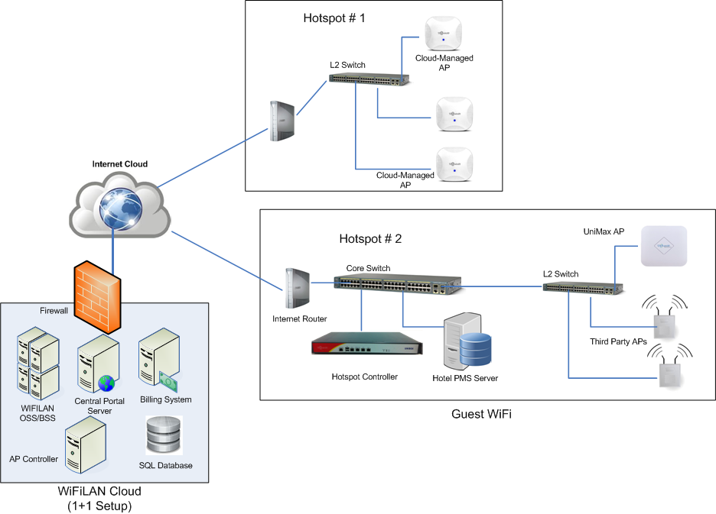
DEPLOYMENT ARCHITECTURE

Slide 15
WIFILAN HOSTING
Hosts servers - RADIUS, Billing, Database, Policy, Monitoring, etc
1+1 configuration for redundancy
Automatic failover
Scalability using Elastic Cloud
Automated Backups
24x7 Monitoring & Alerts
Single Dashboard

Slide 16
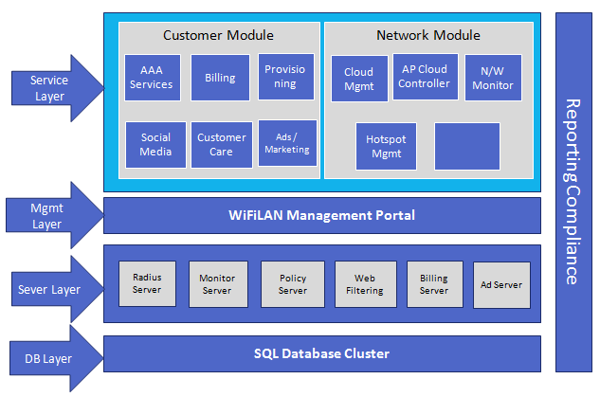
WIFILAN ARCHITECTURE

Slide 17
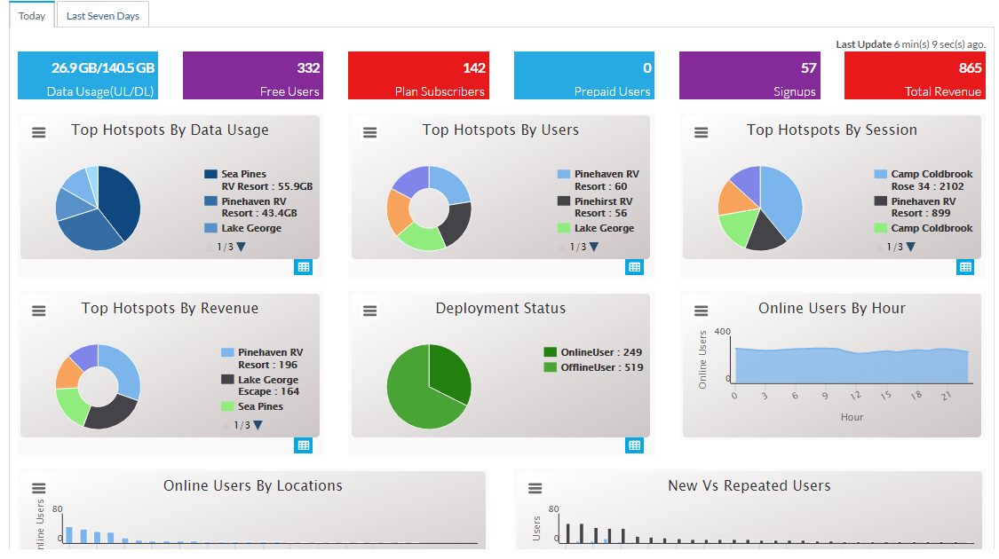
WIFILAN DASHBOARD

Slide 18
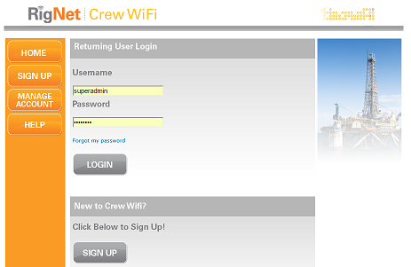
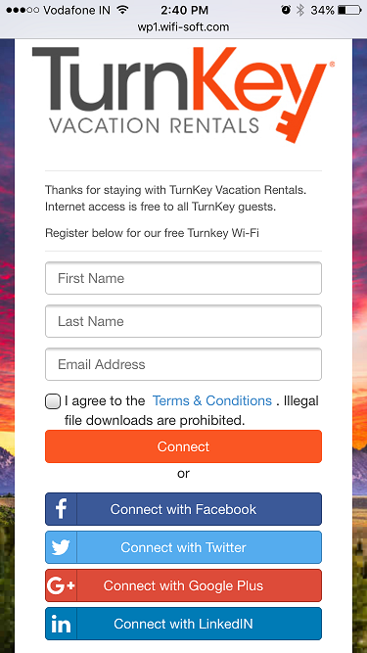
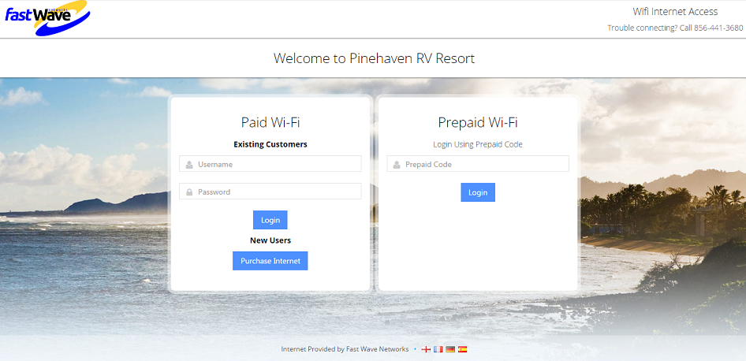
CAPTIVE PORTAL
Fully customized & branded for end client
Responsive & mobile friendly
Customized for every venue/cruise ship
Customizable user experience
Locally hosted to save Internet bandwidth
Multi-lingual support
Customer self-care portal

Slide 19
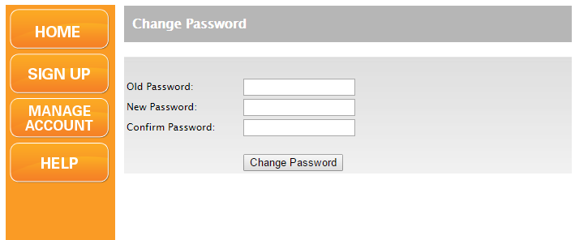
SELF CARE PORTAL
Branded Portals for customer self-care
Change Password, Usage and Billing History
Report a problem
Customer FAQ

Slide 20
RADIUS SERVER
Hosted, scalable and redundant AAA servers
Compatible with APs & gateways of all major vendors
MAC Address authentication
Supports CHAP, EAP, EAP-TLS, EAP-SIM, MSCHAP and 802.1x
Integrated with aggregators like Boingo and iPass
CoA & RADIUS attributes Support

Slide 21
USER MANAGEMENT
Unlimited, scalable, central user database
Automated user provisioning
Multiple Login types – free, paid, vouchers, social media, etc
Detailed logs of login and bandwidth usage
Third party integration – facebook, twitter, LDAP, AD, etc
Billing and transaction history
Customer self-care portal

Slide 22
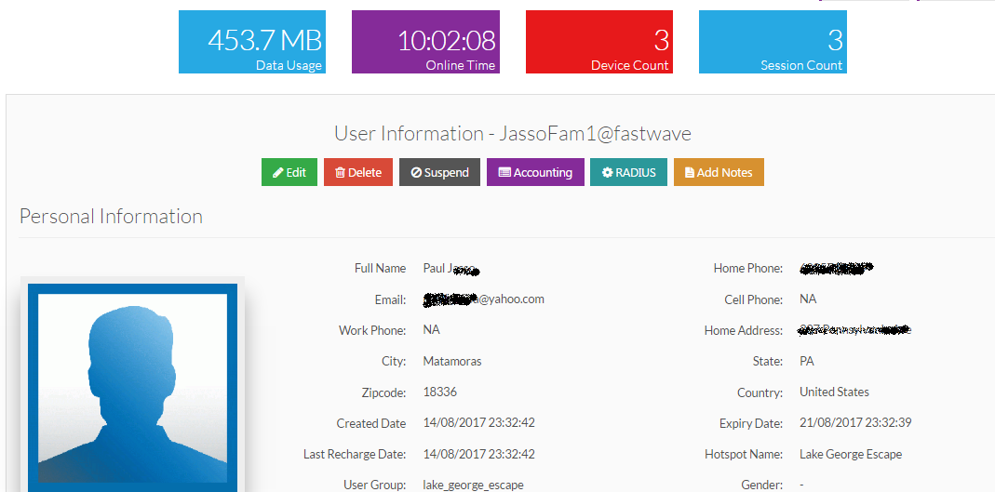
USER MANAGEMENT

Slide 23
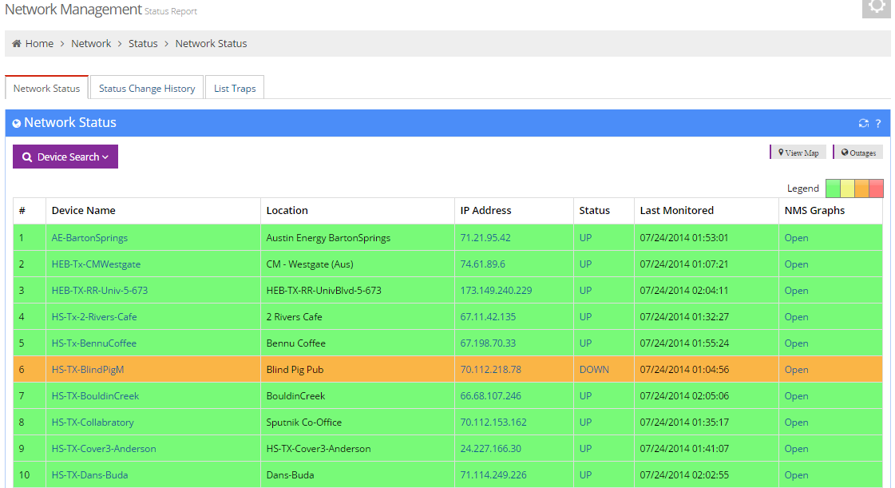
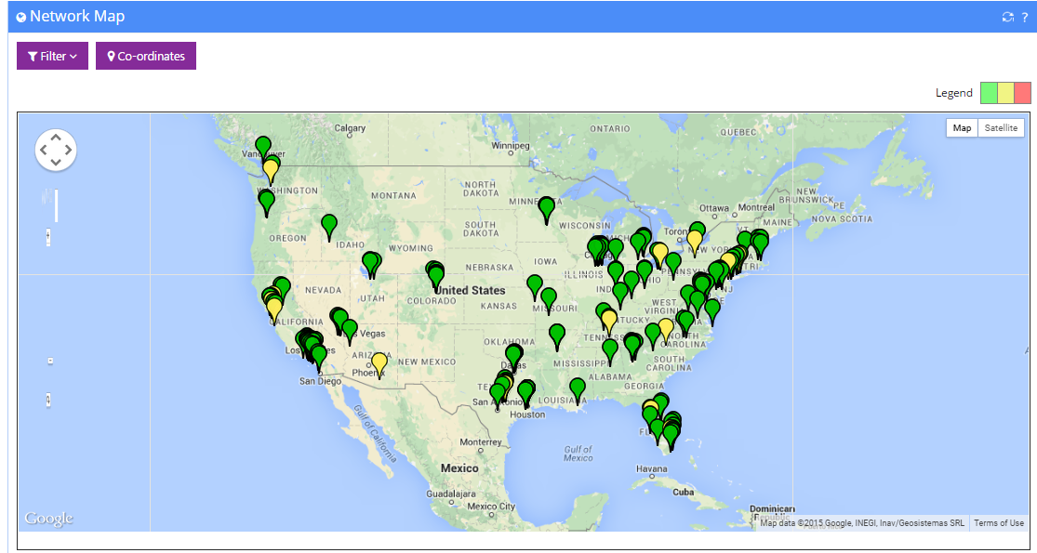
NETWORK MONITORING

Slide 24
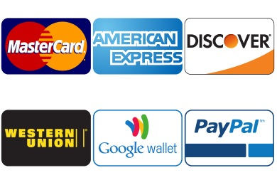
ONLINE BILLING
Integrated online billing on captive portal
Fully automated user provisioning
Integration with leading payment gateways (PayPal, Authorize.Net, etc)
Flexible billing plans – Fixed time, Usage-based, Tiered, Recurring
PMS/Fidelio integration*
Hybrid (Free + Paid) Billing policies
Support for invoices, receipts, taxes & promo codes
* Supported with compatible gateways e.g. Nomadix

Slide 25
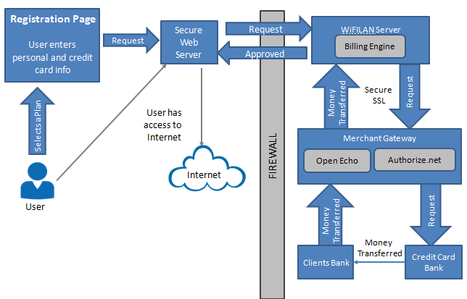
ONLINE BILLING

Slide 26
BANDWIDTH & QoS
Per-user and group-wise bandwidth management
Segregate users into bandwidth classes
Dynamic bandwidth allocation using CoA
Control access based on usage quota
Traffic prioritization*
Detecting bandwidth misuse and alerts
* Needs compatible gateway

Slide 27
VOUCHERS
Vouchers offer offline payment option
Time, bandwidth, speed based restrictions
Customizable voucher templates
Exported in CSV/PDF format for easy distribution
Capture user information when voucher is used
API based voucher generation

Slide 28
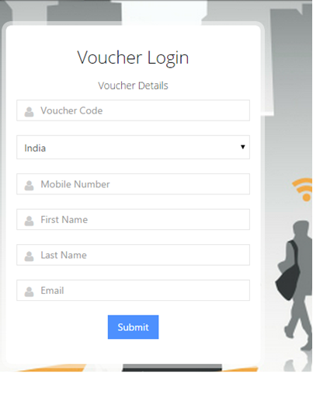
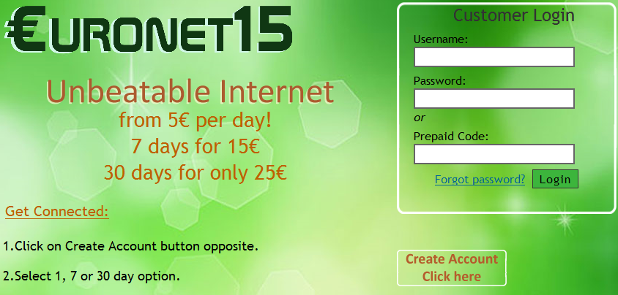
VOUCHERS

Slide 29
SOCIAL MEDIA
Login using social media credentials
Facebook, Twitter, LinkedIn, Google, Instagram
Facebook Check-in and Facebook Like
Improve customer loyalty
Generate social media analytics
Export social media data for offline processing

Slide 30
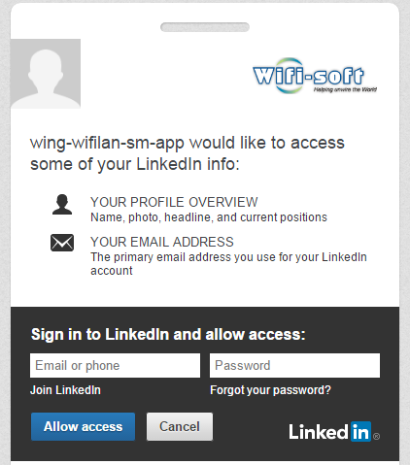
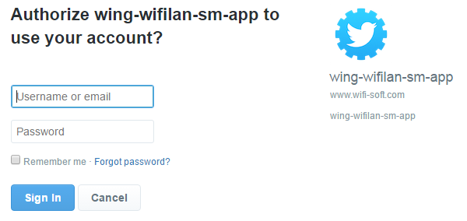
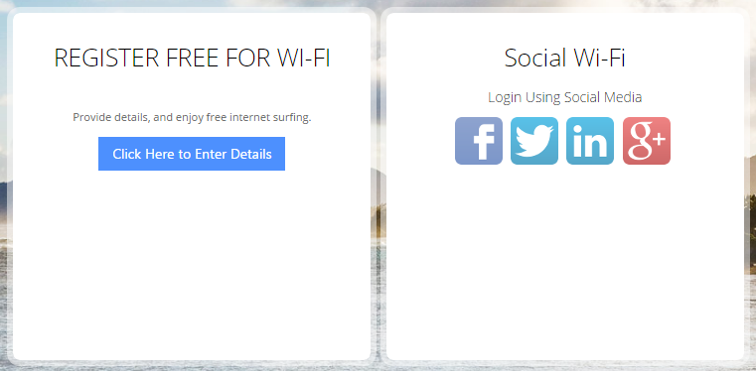
SOCIAL MEDIA

Slide 31
ADVERTISEMENT / PROMOTIONS
Upload Banner and Video Ads
Location based advertisement
Categorize Ads into group e.g. Beverage, Women, etc
Track Ad displays, Ad clicks and location-wise analytics
Automatically format ads for different screens
Push notifications for location-based Ads
Third party ad agency integration

Slide 32
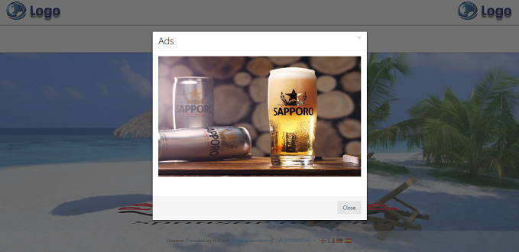
ADVERTISEMENT / PROMOTIONS

Slide 33
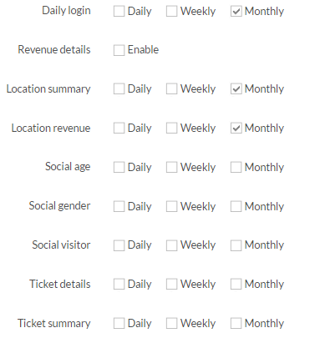
OPERATIONS - REPORTS
Extensive Reporting (50+ reports available)
Reports format – download (PDF, JPG, XLS, CSV)
Automated Reports (daily, weekly, monthly)
Data exported in CSV format for analysis
JSON-based API available for user & network data

Slide 34
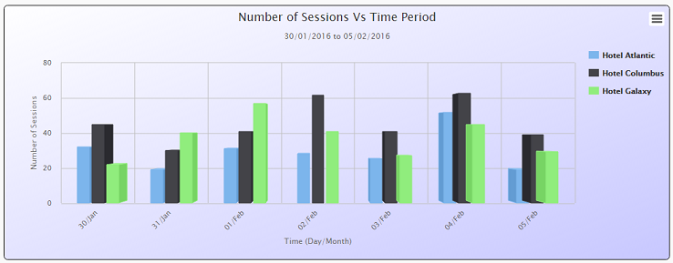
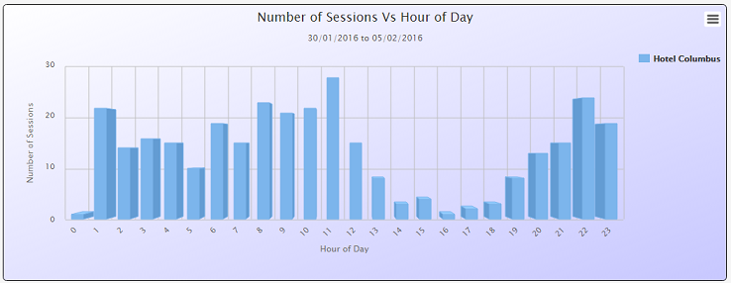
REPORTING
USAGE REPORTS
Detailed Accounting
Usage per user/hotspot
Usage trends
Social Media Analytics
User devices / browsers
NETWORK REPORTS
Bandwidth Usage
Outage Reports & Alerts
Network Reliability
Traffic Analysis
SNMP Traps

Slide 35
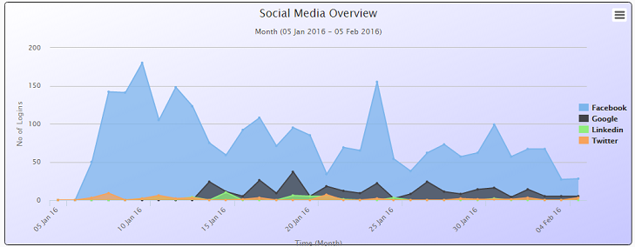
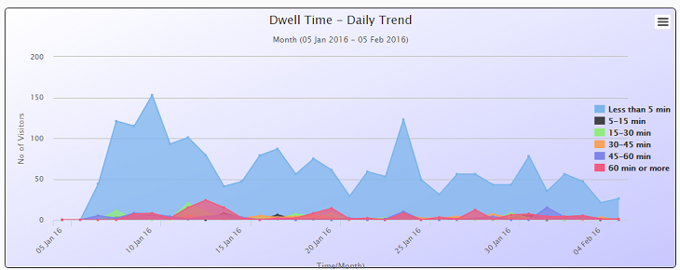
REPORTING
BILLING REPORTS
Revenue by hotspot
Revenue by Dates
Voucher Revenue
PMS Revenue
Detailed billing logs
SOCIAL MEDIA
Gender/Age Report
Dwell time
Visitor logs
Traffic distribution
User Agents
JSON API
AUTOMATED REPORTS
CUSTOM REPORTS

Slide 36
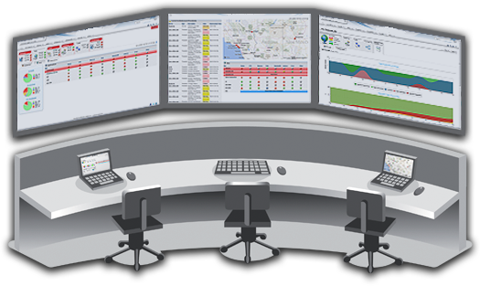
NMS ALERTING
Cloud Servers monitored 24x7
Server event logs and alerting
24x7 monitoring of ISP, Controller & Access Points
Outage alerts via email/SMS
User alerts for over-usage, quota limits and admin events
Email templates for online billing and recurring billing

Slide 37
THIRD PARTY INTEGRATION

Slide 38
THIRD PARTY INTEGRATION
Payment Gateways - Authorize.Net, PayPal, WorldPay, Epay Online,
SMS Gateway - Twilio, Clickatell, SMSGateway Hub
LDAP/AD Integration
Social Media – Facebook, LinkedIn, Google, Twitter, Instagram
Advertisement system (custom)
Aggregators – Boingo, iPass
PMS Systems – Opera/Fidelio, WinHMS, FortuneNEXT, Checkin

Slide 39
MULTI-VENDOR SUPPORT

Slide 40
LICENSING & SUPPORT

Slide 41
SUPPORT / MAINTENANCE
Wifisoft support includes –
Technical support
Full hotspot on-boarding support
Feature upgrades / software patches
Server housing-keeping and upgrades
Captive Portal design and maintenance

Slide 42
SUPPORT LEVELS
# | Severity Level | Description | Action
1 | Level 1 | Network is Down with no work around available. Production has stopped. E.g.: OSS is down. | WiFi-Soft works with customer 24X7 to resolve the situation.
2 | Level 2 | A live location that was previously working has stopped working. | WiFi-Soft works with customer during Extended Business Hours to resolve the situation
3 | Level 3 | Network functionality is severely limited or software is impaired. E.g.: (slow performance) and no work around is available. | WiFi-Soft and Customer work to dedicate resources during normal Business hours to resolve situation.
4 | Level 4 | General Questions, enhancements, and/or documentation errors. | WiFi-Soft and Customer work to during normal business hours to provide assistance as requested.

Slide 43
TRAINING
Online training via Webex available on request
Training includes
WiFiLAN basics
Feature-wise usage instructions
Hotspot on-boarding
Captive Portal & third-party integration
Troubleshooting & Diagnostics

Slide 44
THANKS!
Any questions?
Please contact us at
sales@wifi-soft.com | +1-866-554-5090 | +91-20-3018-5500

