Slide 1
GET TO KNOW US
1
1
Copyright © 2018 Wifi-Soft Solutions Pvt. Ltd. All rights reserved. Do not copy without prior permission

Slide 2
ABOUT US
Long list of satisfied clients
Wifi-soft provides a complete range of wireless networking solutions for managing public and private wireless networks and Wi-Fi hotspots. A few statistics about our company are as below,
Among the top 3 hotspot
companies in the world
Presence in 45+
Countries
One stop shop for any
wifi requirement
10000+ venues
Offices in USA,
UAE and India
Acclaimed brand of the
year 2016 by Silicon India
12+ years of industry
leadership
Resellers in
20+ countries
24x7 customer
support
2
Copyright © 2018 Wifi-Soft Solutions Pvt. Ltd. All rights reserved. Do not copy without prior permission

Slide 3
.01
WIFILAN
.02
UNIBOX
PRODUCT PORTFOLIO
Carrier Grade OSS/BSS
Cloud Managed Hotspots
Version 3.0 – NEW!!
Campus Series
Enterprise Series
SMB Series
.03
UNIMAX
.04
POE SWITCHES & INJECTORS
Indoor
Outdoor
MobiMax
8 Port Series
24 Port Series
3
Copyright © 2018 Wifi-Soft Solutions Pvt. Ltd. All rights reserved. Do not copy without prior permission

Slide 4
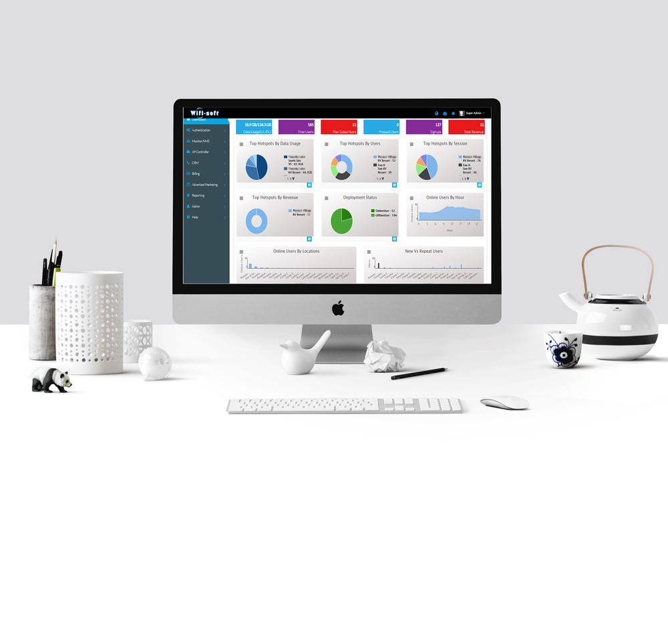
WiFiLAN OSS/BSS/NMS
Ease of deployment
Reasonably priced
Loaded with features
Strong support
Varied applications
Single console operation
WiFiLAN comes in two variants
Carrier-grade WiFi OSS/BSS/NMS
Cloud-based Hotspot Management
READ MORE
Enterprises
Education
Hospitality
Transport
Retail
Public WiFi
4
Copyright © 2018 Wifi-Soft Solutions Pvt. Ltd. All rights reserved. Do not copy without prior permission

Slide 5
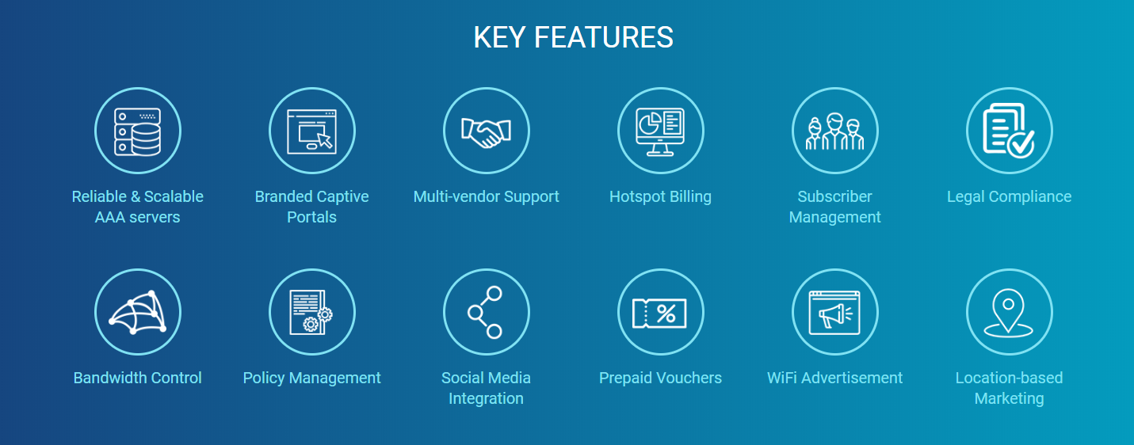
WiFiLAN OSS/BSS/NMS
5
Copyright © 2018 Wifi-Soft Solutions Pvt. Ltd. All rights reserved. Do not copy without prior permission

Slide 6
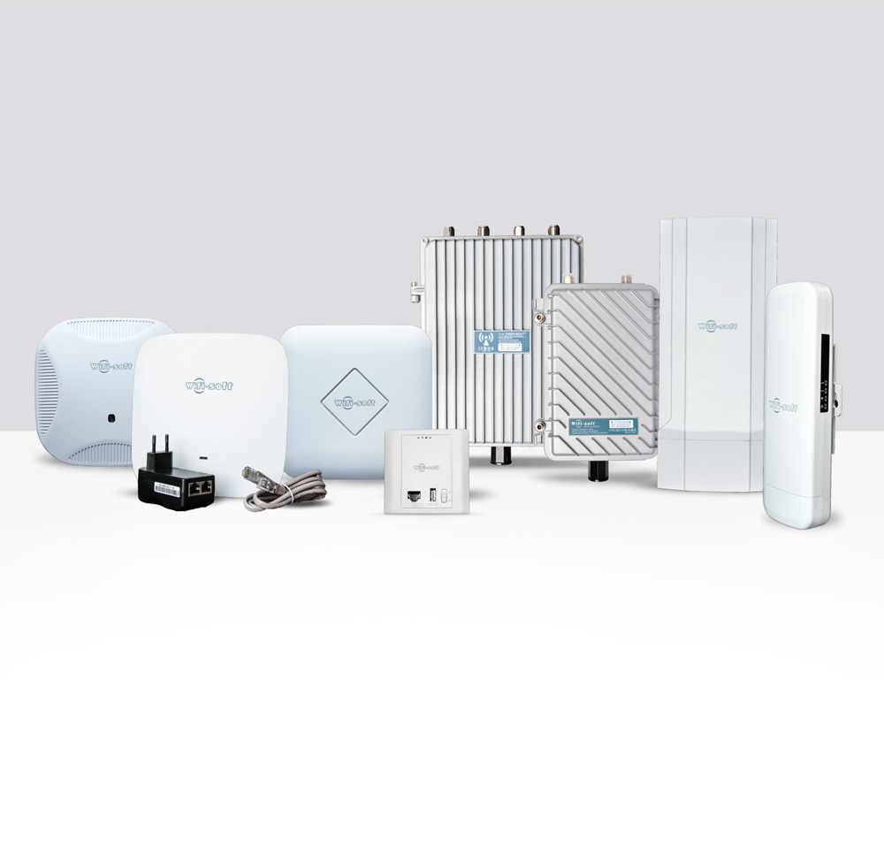
UNIMAX INDOOR & OUTDOOR ACCESS POINTS
Ease of deployment
Reasonably priced
Loaded with features
Strong support
Varied applications
Managed APs
Wide Range
Superior quality
READ MORE
Enterprises
Education
Hospitality
Transport
Retail
Public WiFi
6
Copyright © 2018 Wifi-Soft Solutions Pvt. Ltd. All rights reserved. Do not copy without prior permission

Slide 7
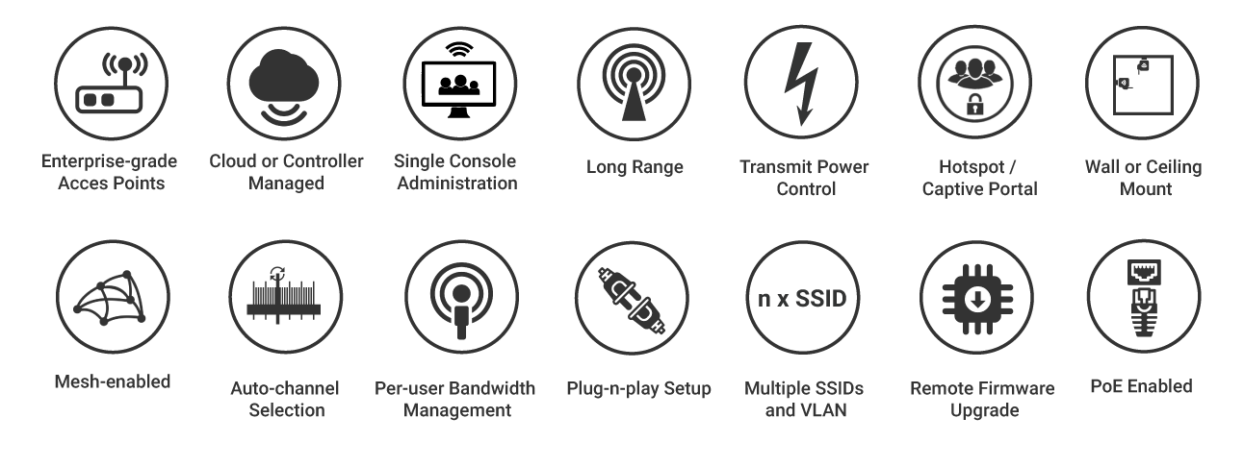
UNIMAX INDOOR & OUTDOOR ACCESS POINTS
KEY FEATURES
7
Copyright © 2018 Wifi-Soft Solutions Pvt. Ltd. All rights reserved. Do not copy without prior permission

Slide 8
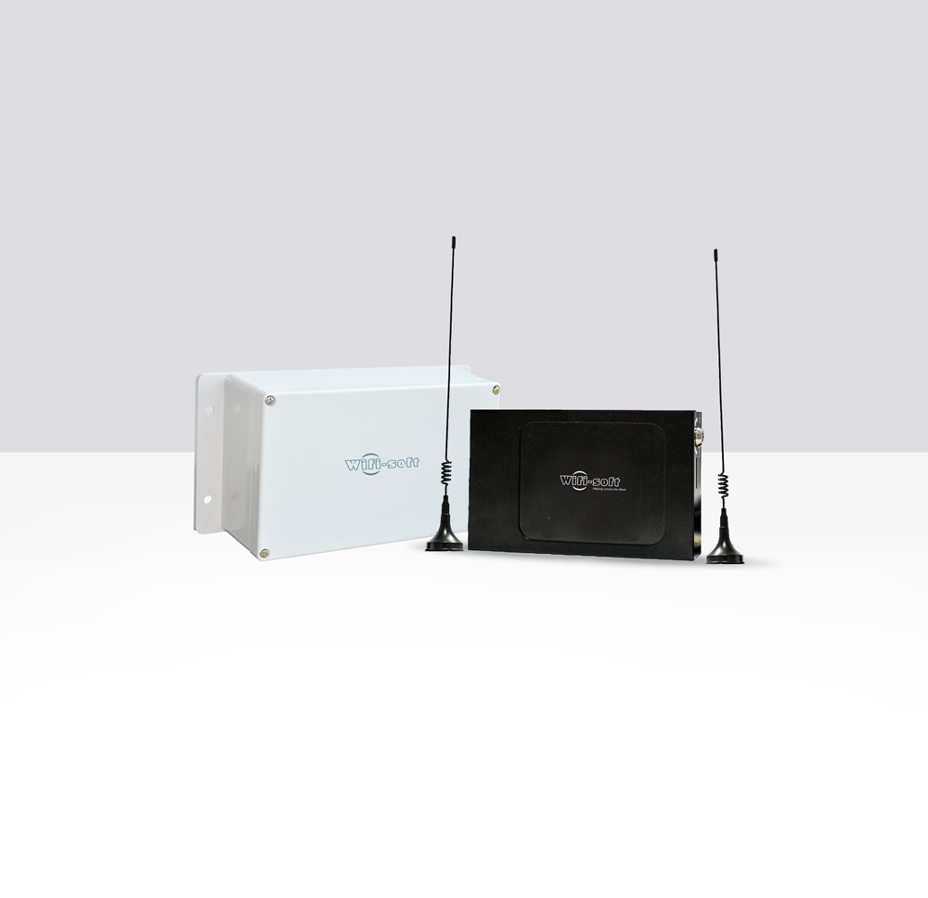
MOBIMAX – 4G/ LTE SERIES
ACCESS POINTS
Ease of deployment
Reasonably priced
Loaded with features
Strong support
Varied applications
Managed APs
Wide Range
Superior quality
Easy connectivity
READ MORE
Enterprises
Education
Hospitality
Transport
Retail
Public WiFi
8
Copyright © 2018 Wifi-Soft Solutions Pvt. Ltd. All rights reserved. Do not copy without prior permission

Slide 9
MOBIMAX 4G/ LTE SERIES
ACCESS POINTS
KEY FEATURES
9
Copyright © 2018 Wifi-Soft Solutions Pvt. Ltd. All rights reserved. Do not copy without prior permission

Slide 10
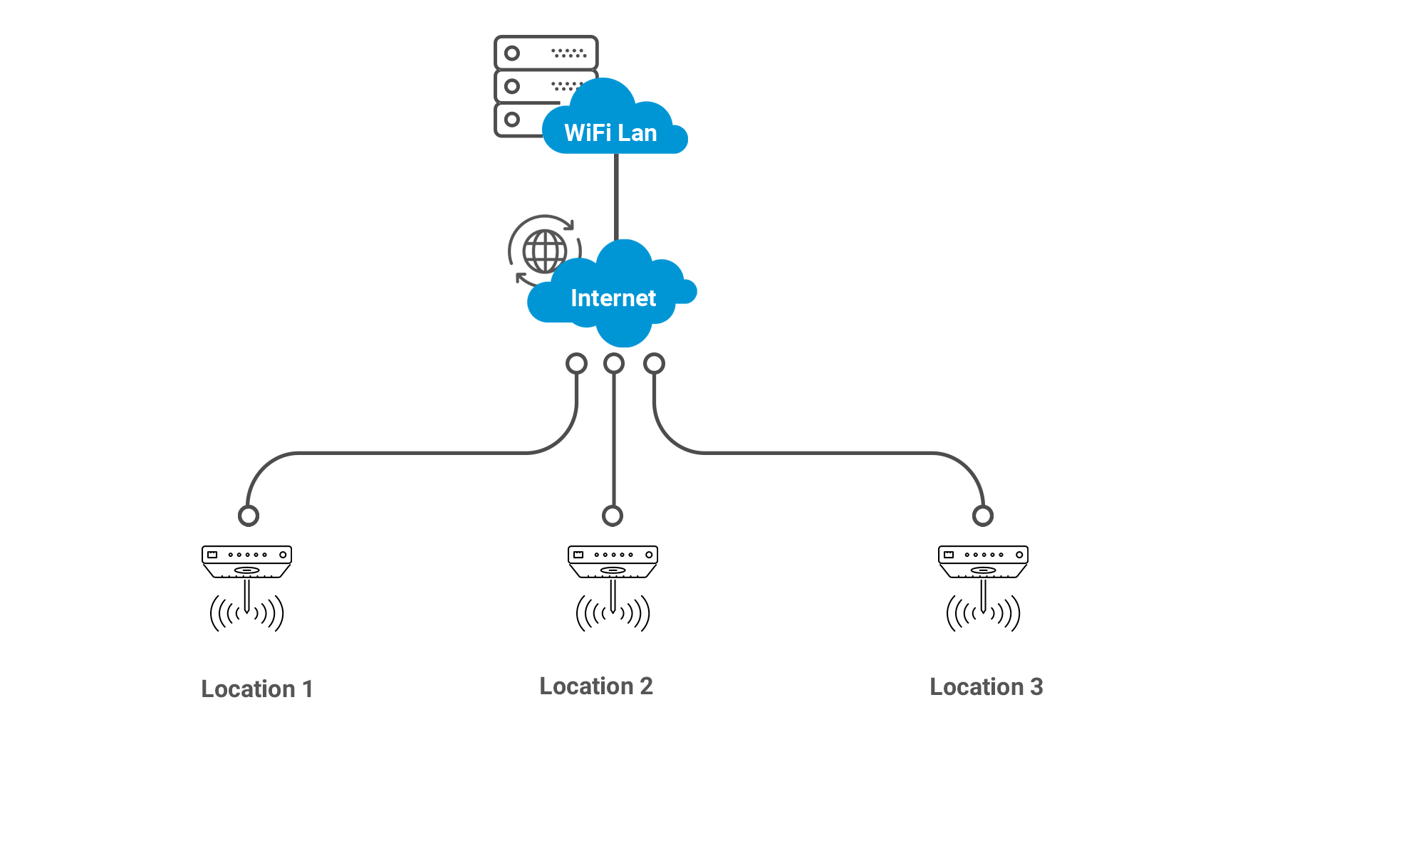
LOCATION WI-FI
Network Architecture Wi-Fi deployment
10
Copyright © 2018 Wifi-Soft Solutions Pvt. Ltd. All rights reserved. Do not copy without prior permission

Slide 11
RETAIL SOLUTIONS
Enterprise Access Points
Push Notifications
Central Management
Portal Advertisements
Branded Captive Portals
SMS/Email Marketing
Customer Surveys
Social Media Integration
Copyright © 2018 Wifi-Soft Solutions Pvt. Ltd. All rights reserved. Do not copy without prior permission

Slide 12
HOW WE
CAN HELP
12
Copyright © 2018 Wifi-Soft Solutions Pvt. Ltd. All rights reserved. Do not copy without prior permission

Slide 13
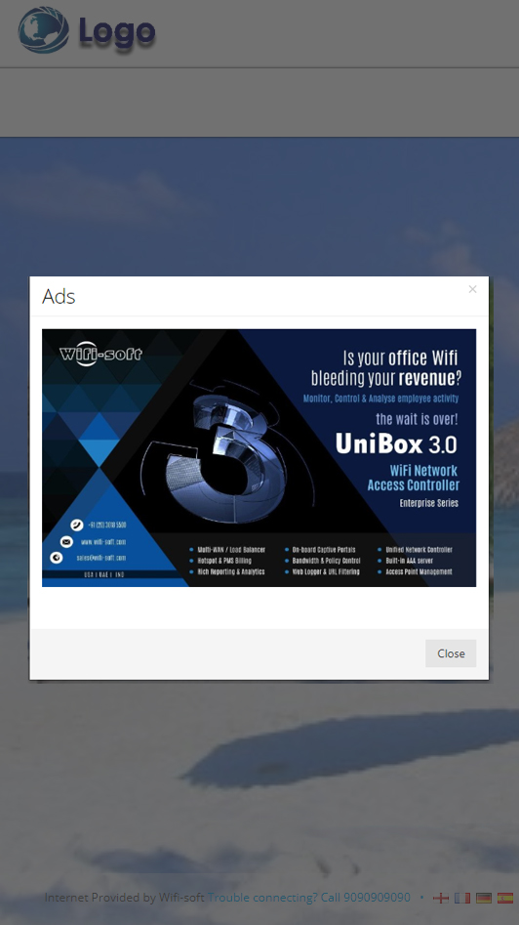
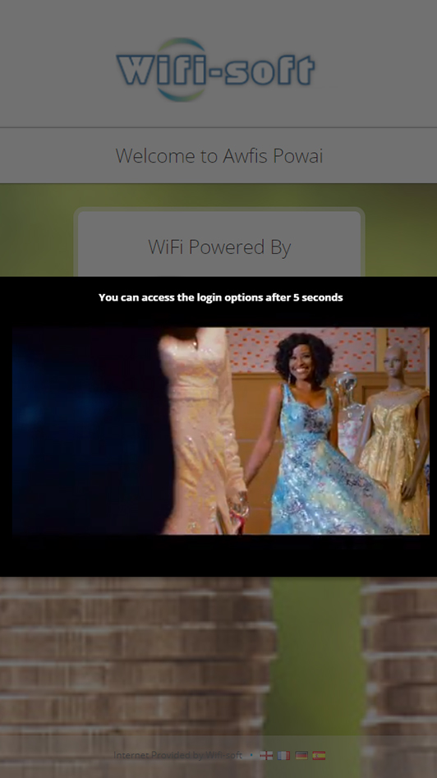
REVENUE GENERATION THROUGH ADS – WIFI MONETIZATION
charging you clientele a nominal fee for your high speed seamless Wi-Fi
13
Copyright © 2018 Wifi-Soft Solutions Pvt. Ltd. All rights reserved. Do not copy without prior permission

Slide 14
PUSH & PULL
MARKETING
14
Copyright © 2018 Wifi-Soft Solutions Pvt. Ltd. All rights reserved. Do not copy without prior permission

Slide 15
CAPTURE CLIENT INFORMATION
15
Copyright © 2018 Wifi-Soft Solutions Pvt. Ltd. All rights reserved. Do not copy without prior permission

Slide 16
SOCIAL MEDIA
LOGINS AND LIKES
16
Copyright © 2018 Wifi-Soft Solutions Pvt. Ltd. All rights reserved. Do not copy without prior permission

Slide 17
Branded captive portal.
Earn additional revenue with Wi-Fi offloading and by showing ads.
Let your customers know of the latest promotions instantly.
Gather client data for re-targeting.
Do everything from a single dashboard.
Get a higher visibility on social media.
Boost customer satisfaction.
WHY US ?
17
Copyright © 2018 Wifi-Soft Solutions Pvt. Ltd. All rights reserved. Do not copy without prior permission

Slide 18
KEY FEATURES
Push Notification
Centralize Administration
Customize login page
Survey of the Wi-Fi user
Reports
Auto login for particular time
Advertisement
URL Filtering
End to end single OEM solution
TRAI Compliance
Centralize Authentication
of wifi users
Good quality equipment's
18
Copyright © 2018 Wifi-Soft Solutions Pvt. Ltd. All rights reserved. Do not copy without prior permission

Slide 19
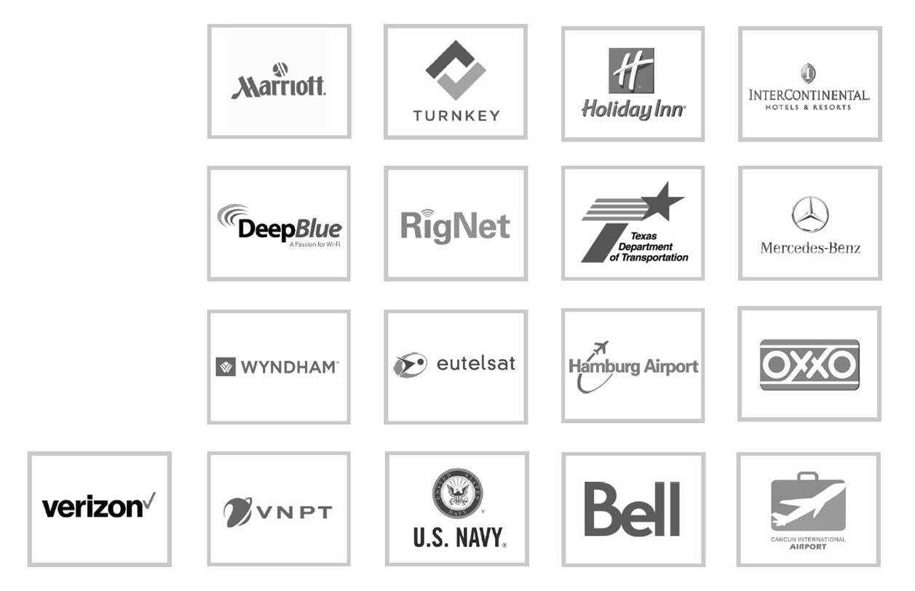
OUR HAPPY
CLIENTS
International Marquee Customers
19
Copyright © 2018 Wifi-Soft Solutions Pvt. Ltd. All rights reserved. Do not copy without prior permission

Slide 20
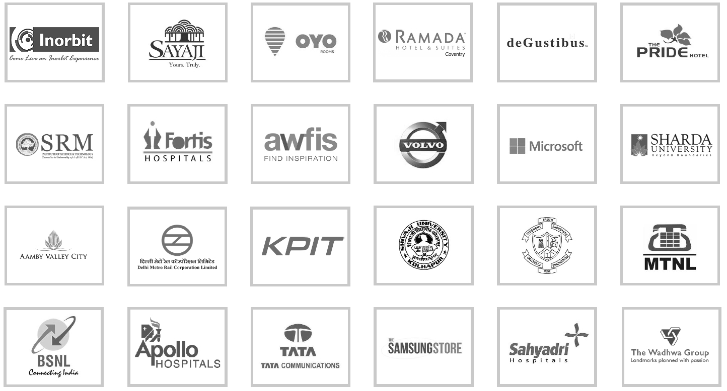
OUR
CLIENTS
Domestic Marquee Customers
20
Copyright © 2018 Wifi-Soft Solutions Pvt. Ltd. All rights reserved. Do not copy without prior permission

Slide 21
RETAIL CASE STUDY
Overview
Requirement
How we helped
For one of the biggest American supermarket chains that only sells ‘natural’ products as per its self-created quality standards, Wifi-soft deployed its state of the art network infrastructure. The company also sells many USDA-certified organic foods and products that aim to be environmentally friendly and ecologically responsible. It has 470 stores in North America and the United Kingdom. The deployment was based on proximity marketing and automated push notifications.
The company wanted to log and analyse visitor data to better understand the spending habits, preferred product categories, busiest time of the day/ year and the overall consumer behavior. They were also interested in knowing which of its outlets was doing better and understand why it was so. WiFi was also to be used as a pull to attract more footfall. They even wanted a customised landing page and 24x7 monitoring.
Reduced OpEx and CapEx
Easy tracking of number of users, bandwidth control, policy management and reporting
Large volume of data to perform consumer behavior analytics
Integrated BYOD support
Simplified and centralized network management
A reduction in network fault calls
Ability to remotely control, monitor and troubleshoot
Ubiquitous Wi-Fi coverage and stronger signal
The ability to support high density environments with more concurrent users per access point
Access point Monitoring
Proximity marketing
Explore all Case Studies
21

Slide 22
CASE STUDY ON DEGUSTIBUS HOSPITALITY PVT. LTD.
Overview
Requirement
How we helped
deGustibus Hospitality was established in early 1996 and enjoys a reputation of being one of the finest hospitality companies in India, with successful restaurants like Indigo, Indigo Delicatessen, Neel, and Tote on the Turf, and the fine catering venture, Moveable Feast, under its umbrella. The company can boast of an experienced and well-trained management team and state-of-the-art culinary infrastructure, and is currently poised for continued expansion and growth.
DeGustibus required a WiFi network to help them advertise on social media, capture client data, perform proximity marketing by pushing ads on patron devices and get online surveys. The solution had to be secure considering the amount of people who walk into their outlets each day.
Reduced OpEx and CapEx
Send push notifications and ads - Proximity Marketing
Customised captive portal
Access after registration. Legally compliant
Easy tracking of users, bandwidth control, policy management and reporting
Mandatory Facebook 'like'
Simplified and centralized network management
Reduction in network fault calls
Ability to remotely control, monitor and troubleshoot
Ubiquitous Wi-Fi coverage and stronger signal
Supports high density environments with more concurrent users per access point
Access point Monitoring
Explore all Case Studies
22

Slide 23
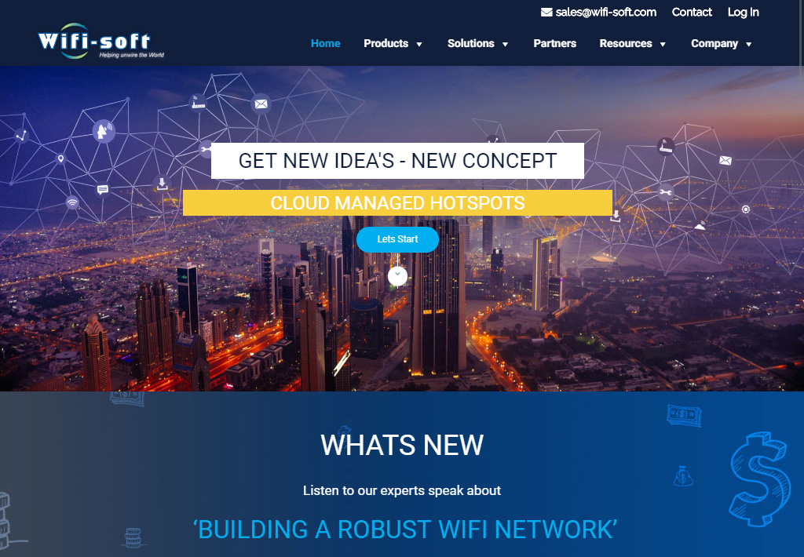
VISIT OUR
WEBSITE TODAY
VISIT NOW
23
Copyright © 2018 Wifi-Soft Solutions Pvt. Ltd. All rights reserved. Do not copy without prior permission

Slide 24
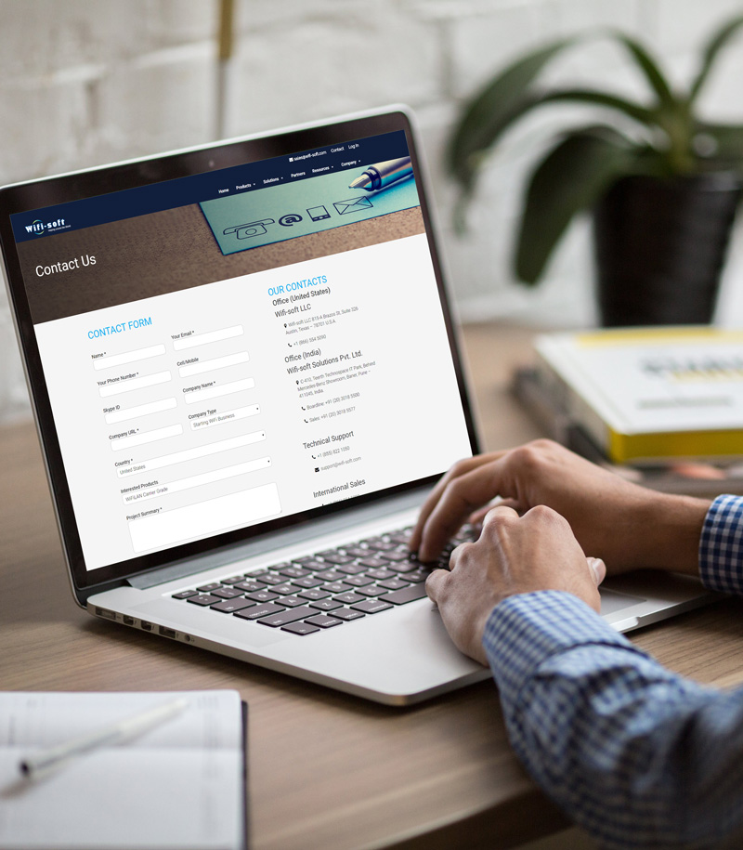
CONTACT
US
Wifi-soft Solutions Pvt. Ltd.
Wifi-soft LLC
815-A Brazos St, Suite 326 Austin, Texas - 78701 U.S.A.
+1 (866) 554 5090
C-410, Teerth Technospace IT Park, Baner, Pune - 411045, India
+91 (20) 3018 5500
sales@wifi-soft.com
IND | UAE | USA
24
Copyright © 2018 Wifi-Soft Solutions Pvt. Ltd. All rights reserved. Do not copy without prior permission

